Slide 1

IMPLEMENTAREA CONCURENTEI IN LIMBAJE DE PROGRAMARE
CONCURENTA IN
JAVA
Ioana Leustean
https://docs.oracle.com/javase/tutorial/essential/concurrency/
https://docs.oracle.com/javase/specs/jls/se23/jls23.pdf
Overview (Java SE 23 & JDK 23) (oracle.com)

Slide 2
Thread
Orice fir de execuție (thread) este un obiect al clasei Thread
Platform thread
" A platform thread is implemented as a thin wrapper around an operating
system (OS) thread.[…] They are suitable for running all types of tasks but may
be a limited resource. "
- daemon threads – sunt oprite când se termină execuția thread-ului principal
- non-daemon threads – își continuă execuția, chiar dacă thread-ul principal și-a terminat-o
Virtual thread
"Virtual threads are suitable for executing tasks that spend most of the time blocked,
often waiting for I/O operations to complete. Virtual threads are not intended for long
running CPU intensive operations."
- sunt întotdeauna thread-uri daemon
API-ul pentru concurență: java.util.concurrent

Slide 3
Virtual Threads (Java 23)
" every instance of java.lang.Thread in the JDK is a platform thread. A platform thread runs Java code on an underlying OS thread and captures the OS thread for the code's entire lifetime. The number of platform threads is limited to the number of OS threads.
A virtual thread is an instance of java.lang.Thread that runs Java code on an underlying OS thread but does not capture the OS thread for the code's entire lifetime. This means that many virtual threads can run their Java code on the same OS thread, effectively sharing it. While a platform thread monopolizes a precious OS thread, a virtual thread does not. The number of virtual threads can be much larger than the number of OS threads.
Virtual threads are a lightweight implementation of threads that is provided by the JDK rather than the OS. They are a form of user-mode threads, which have been successful in other multithreaded languages (e.g., goroutines in Go and processes in Erlang). […] Virtual threads employ M:N scheduling, where a large number (M) of virtual threads is scheduled to run on a smaller number (N) of OS threads."
JEP 444: Virtual Threads

Slide 4
Virtual Threads (Java 23)
" every instance of java.lang.Thread in the JDK is a platform thread. A platform thread runs Java code on an underlying OS thread and captures the OS thread for the code's entire lifetime. The number of platform threads is limited to the number of OS threads.
A virtual thread is an instance of java.lang.Thread that runs Java code on an underlying OS thread but does not capture the OS thread for the code's entire lifetime. This means that many virtual threads can run their Java code on the same OS thread, effectively sharing it. While a platform thread monopolizes a precious OS thread, a virtual thread does not. The number of virtual threads can be much larger than the number of OS threads.
Virtual threads are a lightweight implementation of threads that is provided by the JDK rather than the OS. They are a form of user-mode threads, which have been successful in other multithreaded languages (e.g., goroutines in Go and processes in Erlang). […] Virtual threads employ M:N scheduling, where a large number (M) of virtual threads is scheduled to run on a smaller number (N) of OS threads."
Non-Goals
It is not a goal to remove the traditional implementation of threads, or to silently migrate existing applications
to use virtual threads.
It is not a goal to change the basic concurrency model of Java.
It is not a goal to offer a new data parallelism construct in either the Java language or the Java libraries.
JEP 444: Virtual Threads

Slide 5
Thread (platform thread)
Orice fir de execuție (thread) este un obiect al clasei Thread
Atributele unui thread
ID - unic pentru fiecare thread
- este accesat cu getId, nu poate fi modificat
Name - este un String
- este accesat cu : getName, setName
Priority - un număr între 1 si 10
- este accesata cu: getPriority, setPriority
- în principiu thread-urile cu prioritate mai mare sunt executate primele
- setarea priorității nu oferă garanții în privința execuției
Status - este accesat cu: getState
- nu poate fi modificat direct (e.g. nu există setState)
Thread (Java SE 22 & JDK 22) (oracle.com)

Slide 6
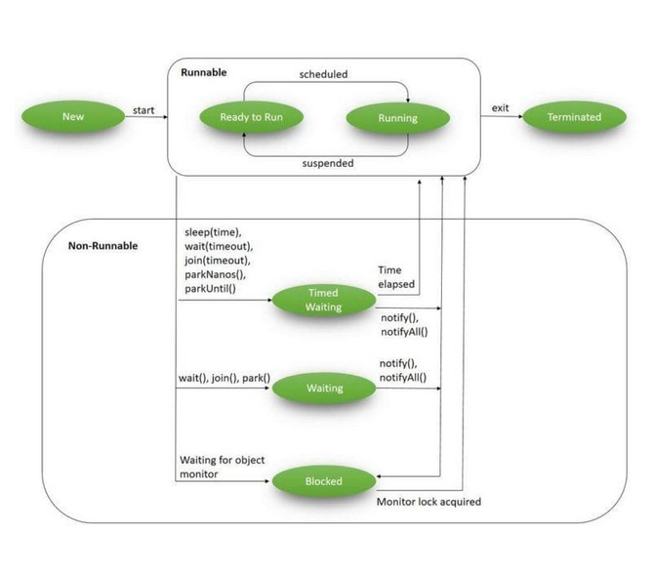
Enum Thread.State
public static enum Thread.State
extends Enum<Thread.State>
Starile posibile ale unui thread:
NEW: create dar care nu si-a inceput executia
RUNNABLE: in executie
BLOCKED: blocat de lacatul unui monitor
WAITING: asteapta ca un alt thread sa execute o actiune
un thread ajunge in aceasta stare dupa apelul metodelor Object.wait(), Thread.join()
TIMED_WAITING: asteapta un alt thread, dar numai un timp limitat
un thread ajunge in aceasta stare dupa apelul metodelor Object.wait(t), Thread.join(t), Thread.sleep(t)
TERMINATED: thread-ul si-a terminat executia
https://www.baeldung.com/java-thread-lifecycle
Thread.State (Java SE 23 & JDK 23)

Slide 7
Crearea obiectelor de tip Thread:
Metoda directă
ca subclasă a clasei Thread
implementarea interfeței Runnable
Metoda abstractă
folosind clasa Executors
public interface Runnable{
public void run() ;
}
public class Thread
extends Object
implements Runnable

Slide 8
Definirea unui thread ca subclasă a clasei Thread
public class HelloThread extends Thread {
public void run() {
System.out.println("Hello from a thread!");
}
public static void main(String args[]) {
HelloThread t = new HelloThread();
t.start();
}}
definim o subclasă a clasei Thread
cu propria metoda run()
definim thread-ul ca un obiect din noua clasa
și îl pornim folosind metoda start()
metoda start() porneste thread-ul creand un fir de exeutie separat
metoda run() contine ceea ce executa thread-ul dupa apelul metodei start()

Slide 9
Definirea unui thread ca subclasă anonimă a clasei Thread
public class HelloThreadAn {
public static void main(String args[]) {
Thread t = new Thread() { public void run() {
System.out.println("Hello from a thread!");
}};
t.start();
}}

Slide 10
Definirea unui thread prin implementarea interfeței Runnable
Interfața Runnable conține o singura metodă: run()
public class HelloRunnable implements Runnable {
public void run() {
System.out.println("Hello from a thread!");
}
public static void main(String args[]) {
Thread t = new Thread (new HelloRunnable());
t.start();
}}
apelul metodei start() creaza un fir de executie separat, in care este apelata metoda run() a obiectului respectiv

Slide 11
Clasa Thread
public class Thread
extends Object
implements Runnable
Metodele ale instanțelor:
run()
start()
join()
join(long millisecunde)
interrupt()
boolean isAlive()
Metode statice
( se aplică thread-ului current):
yield()
sleep(long milisecunde)
currentThread()

Slide 12
Clasa Thread
public class Thread
extends Object
implements Runnable
Metodele ale instanțelor:
start()
porneste thread-ul intr-un fir de executie separate si invoca run()
run()
este suprascrisa sau apelata din Runnable
join(), join(long millisecunde)
este invocata de thread-ul curent pe un al doilea thread;
thread-ul current este blocat pana cand al doilea thread isi termina executia sau
pana cand expira timpul (milisecunde)
interrupt()
este folosit in situatia in care un thread cere altui thread t sa isi intrerupa executia;
intrerupe executia thread-ului t daca acesta este in stare de asteptare, in caz contrar seteaza un flag
boolean isAlive()
intoarce true atata timp cat thread-ul nu si-a incetat executia

Slide 13
Clasa Thread
public class Thread
extends Object
implements Runnable
Metode statice ( se aplică thread-ului current):
yield()
thread-ul cedeaza randul altui thread care are aceeasi prioritate
sleep(long milisecunde)
thread-ul este suspendat pentru numarul de milisecunde precizat
currentThread()
intoarce o referinta la thread-ul care invoca metoda

Slide 14
Multi-threading în Java
O aplicație Java pornește (prin apelul funcției main) un thread, numit thread-ul principal.
Fiecare thread are o prioritate, care poate fi setată de programator.
Fiecare thread are propria stivă dar poate accesa și datele partajate din memoria heap.
Execuția thread-urilor este nedeterministă.
JVM continuă să execute thread-uri până când:
este apelată metoda exit a clasei Runtime
toate thread-urile utilizator și-au terminat executia (normal sau printr-o excepție)

Slide 15
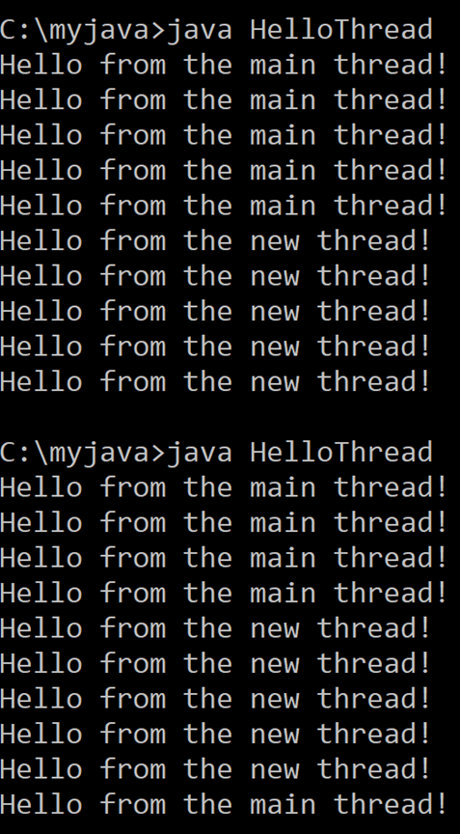
Executia este nedeterministă
public class HelloThread implements Runnable {
public void run() {
for (int x = 0; x < 5; x = x + 1)
System.out.println("Hello from the new thread!");
}
public static void main(String args[]) {
Thread t = new Thread (new HelloThread());
t.start();
for (int x = 0; x < 5; x = x + 1)
System.out.println("Hello from the main thread!");
}}

Slide 16
Execuția este nedeterministă
public class HelloThread implements Runnable {
public void run() {
for (int x = 0; x < 5; x = x + 1)
System.out.println("Hello from the new thread!");
}
public static void main(String args[]) {
Thread t = new Thread (new HelloThread());
t.start();
for (int x = 0; x < 5; x = x + 1)
System.out.println("Hello from the main thread!");
}}
Thread-ul "copil" continua
executia dupa ce thread-ul
principal si-a incheiat-o.

Slide 17
join() si InterruptedException
public class HelloThread implements Runnable {
public void run() {
for (int x = 0; x < 1000; x = x + 1)
System.out.println("Hello from the new thread!");
}
public static void main(String args[]) throws InterruptedException {
Thread t = new Thread (new HelloThread());
t.start();
for (int x = 0; x < 1000; x = x + 1)
System.out.println("Hello from the main thread!");
t.join();
}}
Thread-ul current (in exemplu thread-ul principal) intra in stare de asteptare pana cand
thread-ul t isi va termina executia; daca threadul t este intrerupt va arunca o exceptie.

Slide 18
Transmiterea unui parametru către un thread
public static void main(String args[]) {
Scanner myInput = new Scanner( System.in );
int n;
System.out.print( "Enter n " );
n=myInput.nextInt();
Thread t = new Thread (new HelloThread(n));
t.start();
for (int x = 0; x < n; x = x + 1)
System.out.println("Hello from the main thread");
}}

Slide 19
Transmiterea unui parametru catre un thread
import java.util.Scanner;
public class HelloThread implements Runnable {
private int n;
public HelloThread(int n){this.n=n;}
public void run() {
for (int x = 0; x < n; x = x + 1)
System.out.println("Hello from " + Thread.currentThread().getId()+"!");
}
public static void main(String args[]) {
Scanner myInput = new Scanner( System.in );
int n;
System.out.print( "Enter n " );
n=myInput.nextInt();
Thread t = new Thread (new HelloThread(n));
t.start();
for (int x = 0; x < n; x = x + 1)
System.out.println("Hello from the main thread!"); }}
parametrul este transmis constructorului

Slide 20
sleep(ms) si InterruptedException
https://docs.oracle.com/javase/tutorial/essential/concurrency/sleep.html
public class SleepMessages {
public static void main(String args[]) throws InterruptedException {
String importantInfo[] = { “This", “is “, “important"};
for (int i = 0; i < importantInfo.length; i++) {
//pauza 4 secunde
Thread.sleep(4000);
System.out.println(importantInfo[i]);
}
}}
opreste executia threadului curent pentru ms milisecunde si arunca exceptie daca threadul este intrerupt

Slide 21
sleep(ms) cu tratarea InterruptedException
https://docs.oracle.com/javase/tutorial/essential/concurrency/simple.html
public class MessageLoop implements Runnable {
public void run() {
String importantInfo[] = {“This”, “is”, “important”};
try {
for (int i = 0; i < importantInfo.length;i++) {
Thread.sleep(4000);
threadMessage(importantInfo[i]);
}
} catch (InterruptedException e) {
threadMessage("I wasn't done!");
}}
daca thread-ul este intrerupt
se va afisa acest mesaj
Thread-ul secundar este creat prin implementarea interfetei Runnable

Slide 22
sleep(ms) cu tratarea InterruptedException
Thread-ul principal creaza un al doilea thread si asteapt ca acesta sa isi termine executia.
public static void threadMessage(String message) {
String threadName = Thread.currentThread().getName();
System.out.format("%s: %s%n", threadName, message); }
public static void main(String args[]) throws InterruptedException {
threadMessage("Starting MessageLoop thread");
Thread t = new Thread(new MessageLoop());
t.start();
threadMessage("Waiting for MessageLoop thread to finish");
t.join();
threadMessage("Finally!");}}

Slide 23
public static void main(String args[]) throws InterruptedException {
threadMessage("Starting MessageLoop thread");
Thread t = new Thread(new MessageLoop());
t.start();
threadMessage("Waiting for MessageLoop thread to finish");
t.interrupted();
t.join();
threadMessage("Finally!");}

Slide 24
Comunicarea între thread-uri
doua thread-uri care incrementeaza acelasi contor
public class SharedCounter {
static int c = 0;
public static void main(String[] args) {
Thread myThread = new Thread(() -> { for (int x = 0; x < 5000; ++x) c++; });
myThread.start();
for (int x = 0; x < 5000; ++x) c--;
System.out.println("c = " + c);
}}
>java SharedCounter.java
c=-5000

Slide 25
Comunicarea între thread-uri
doua thread-uri care incrementeaza acelasi contor
public class SharedCounter {
static int c = 0;
public static void main(String[] args) throws InterruptedException {
Thread myThread = new Thread(() -> { for (int x = 0; x < 5000; ++x) c++; });
myThread.start();
Thread.sleep(3000);
for (int x = 0; x < 5000; ++x) c--;
System.out.println("c = " + c);
}}
durata executiei?
>java SharedCounter.java
c=0

Slide 26
Comunicarea între thread-uri
doua thread-uri care incrementeaza acelasi contor
public class SharedCounter {
static int c = 0;
public static void main(String[] args) throws InterruptedException {
Thread myThread = new Thread(() -> {
for (int x = 0; x < 5000; ++x) c++;
});
myThread.start();
for (int x = 0; x < 5000; ++x) c--;
myThread.join();
System.out.println("c = " + c);
}}

Slide 27
Comunicarea între thread-uri
doua thread-uri care incrementeaza acelasi contor
public class SharedCounter {
static int c = 0;
public static void main(String[] args) throws InterruptedException {
Thread myThread = new Thread(() -> { for (int x = 0; x < 5000; ++x) c++; });
myThread.start();
for (int x = 0; x < 5000; ++x) c--;
myThread.join();
System.out.println("c = " + c);
}}
accesul la contor nu este sincronizat!
>java SharedCounter.java
c=0

Slide 28
Comunicarea între thread-uri
doua thread-uri care incrementeaza acelasi contor
public class Interference implements Runnable {
static Integer counter = 0;
public void run () {
for (int i = 0; i < 5; i++) {
performTask();
}}
private void performTask () {
int temp = counter;
counter++;
System.out.println(Thread.currentThread()
.getName() + " - before: "+temp+" after:" + counter);}
public static void main (String[] args) {.. }}

Slide 29
Comunicarea între thread-uri – data race
doua thread-uri care incrementeaza acelasi contor
public static void main (String[] args) {
Thread thread1 = new Thread(new Interference());
Thread thread2 = new Thread(new Interference()); thread1.start(); thread2.start();
thread1.join(); thread2.join(); }
data race

Slide 30
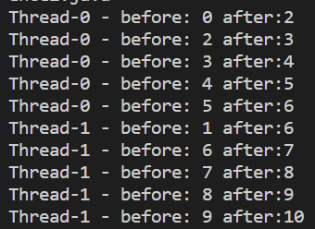


Comunicarea între thread-uri – data race
doua thread-uri care incrementeaza acelasi contor
public static void main (String[] args) {
Thread thread1 = new Thread(new Interference());
Thread thread2 = new Thread(new Interference()); thread1.start(); thread2.start();
thread1.join(); thread2.join(); }
data race

Slide 31
Mecanismul de sincronizarea thread-urilor
Fiecare obiect are un lacăt intern (intrinsic lock, monitor lock).
Un thread care acceseaza un obiect:
deține (aquire) lacătul intern al obiectului,
accesează/modifică datele obiectului,
eliberează (release) lacătul intern al obiectului.
In timpul în care un thread deține lacătul intern al unui obiect, orice alt
thread care dorește să dețină (acquire) lacătul este blocat.

Slide 32
Sincronizarea thread-urilor se face cu:
Metode sincronizate
private synchronized void syncMethod () {
//codul metodei
}
Cand un thread apelează o metoda sincronizată el trebuie să dețină lacătul obiectului caruia îi aparține metoda, execută metoda apoi eliberează lacatul.
acquire, execute, release
Pentru metodele statice, lacătul este al obiectului Class asociat clasei respective.

Slide 33
Sincronizarea thread-urilor
Metode sincronizate
Instructiuni (blocuri) sincronizate
private synchronized void syncMethod () {
//codul metodei
}
synchronized (object reference){
// instructiuni
}
se specifica obiectul
care detine lacatul
private void syncMethod () {
synchronized (this){
//codul metodei
}}
O metoda sincronizata poate fi scrisa ca bloc sincronizat:

Slide 34
Comunicarea intre thread-uri
doua thread-uri care incrementeaza acelasi contor
public class Interference {
public static void main (String[] args) throws InterruptedException {
Counter c = new Counter();
Thread thread1 = new Thread(new CounterThread(c));
Thread thread2 = new Thread(new CounterThread(c));
thread1.start(); thread2.start();
thread1.join(); thread2.join();
}
}
class CounterThread implements Runnable {
Counter counter;
CounterThread (Countercounter){this.counter=counter;}
public void run(){}
}
Class Counter{…}

Slide 35
Comunicarea intre thread-uri
doua thread-uri care incrementeaza acelasi contor
class CounterThread implements Runnable {
Counter counter;
CounterThread (Counter counter) {this.counter=counter;}
public void run () {
for (int i = 0; i < 5; i++) {
counter.performTask();
}
}
}
class Counter{
private int counter = 0;
public void performTask () {}
}

Slide 36
Comunicarea intre thread-uri
doua thread-uri care incrementeaza acelasi contor
class CounterThread implements Runnable {
Counter counter;
CounterThread (Counter counter) {this.counter=counter;}
public void run () {}
}
class Counter{
private int counter = 0;
public void performTask () {
int temp = counter;
counter++;
System.out.println(Thread.currentThread()
.getName() + " - before: "+temp+" after:" + counter);
}}

Slide 37
Comunicarea intre thread-uri – data race
doua thread-uri care incrementeaza acelasi contor
public class Interference {
public static void main (String[] args) throws InterruptedException {
Counter c = new Counter();
Thread thread1 = new Thread(new CounterThread(c));
Thread thread2 = new Thread(new CounterThread(c)); thread1.start(); thread2.start();
thread1.join(); thread2.join();
}
}
data race

Slide 38
Metode sincronizate
class CounterThread implements Runnable {
SCounter scounter;
CounterThread (SCounter scounter) {this.scounter=scounter;}
public void run () {}
}
class SCounter{
private int scounter = 0;
public synchronized void performTask () {
int temp = scounter;
scounter++;
System.out.println(Thread.currentThread()
.getName() + " - before: "+temp+" after:" + scounter);
}}

Slide 39
Metode sincronizate
doua thread-uri care incrementeaza acelasi contor
public class Interference {
public static void main (String[] args) throws InterruptedException {
SCounter sc = new SCounter();
Thread thread1 = new Thread(new CounterThread(sc));
Thread thread2 = new Thread(new CounterThread(sc)); thread1.start(); thread2.start();
thread1.join(); thread2.join();
}
}
lacatul este pe sc

Slide 40
Blocuri sincronizate
class CounterThread implements Runnable {
SCounter scounter;
CounterThread (SCounter scounter) {this.scounter=scounter;}
public void run () {}
}
class SCounter{
private int scounter = 0;
private Object counter_lock = new Object();
public void performTask () {
synchronized (counter_lock){
int temp = scounter;
scounter++;
System.out.println(Thread.currentThread()
.getName() + " - before: "+temp+" after:" + scounter);
}}}
lacatul este pe counter_lock

Slide 41
Mecanismul de sincronizarea thread-urilor prin lacatul intern
Orice obiect din Java are asociat un lacat (monitor).
O metoda sincronizata, atunci cand este invocata, va fi executata numai daca detine lacatul obiectului,
acesta fiind eliberat automat dupa ce metoda este executata.
Numai un singur thread poate detine lacatul obiectului la un moment dat.
Un thread detine lacatul intern al unui obiect daca:
executa o metoda sincronizata a obiectului,
executa un bloc sincronizat de obiect ,
daca obiectul este Class, thread-ul executa o metoda static sincronizata .
Un thread poate face aquire pe un lacat pe care deja il detine (reentrant synchronization):
public class reentrantEx {
public synchronized void met1{}
public synchronized void met2{ this.met1() ;}
}
Astfel, se evita situatia in care un thread intra in
deadlock incercand sa detina un lacat pe care
deja il detine.

Slide 42
Modelul de memorie JAVA
Fiecare thread are propria stiva de executie, heap-ul este comun pentru toate thread-urile.
Erorile de consistenta a memoriei apar atunci cand thread-uri diferite au vad in mod inconsistent
datele comune.
Accesul la memoria comuna este reglementat de relatia happens-before care stabileste cand
modificarile facute de un thread sunt vizibile altui thread:
daca actiunea X este in relatie happens-before cu actiunea Y atunci
exita garantia ca thread-ul care executa Y va vedea rezultatele actiunii X
In absenta relatiei happens-before actiunile pot fi reordonate (compiler optimization).
https://docs.oracle.com/javase/tutorial/essential/concurrency/memconsist.html
https://docs.oracle.com/javase/specs/jls/se23/html/jls-17.html#jls-17.4

Slide 43
Happens-before
daca actiunea X este in relatie happens-before cu actiunea Y atunci
exita garantia ca thread-ul care executa Y va vedea rezultatele actiunii X
Relatia happens-before este o relatie de ordine partial pe toate actiunile unui program.
Relatia happens-before este tranzitiva.
Reguli care definesc happens-before
Thread unic: in cadrul aceluiasi thread, relatia happens-before este stabilita de ordinea actiunilor in program.
Monitor: orice actiune unlock pe un lacat este in relatia happens-before cu orice actiune lock ulterioara pe acelasi lacat.
Variabile volatile: scrierea unei variabile volatile este in relatia happens-before cu orice citire ulterioara a variabilei.
Thread.start(): actiunea thread1.start() este in relatia happens-before cu orice actiune din thread1
actiunea de pornire a unui thread este in relatia happens-before cu orice alta actiune din thread-ul respective
Thread.join(): orice actiune din thread1 este in relatia happens-before cu orice actiune ulterioara lui thread1.join()
https://www.logicbig.com/tutorials/core-java-tutorial/java-multi-threading/happens-before.html
Exista reguli care defines relatia happens-before pentru clasele din java.util.concurrent:
https://docs.oracle.com/javase/specs/jls/se23/html/jls-17.html#jls-17.4

Slide 44
Vizibilitate si Atomicitate
Interactiune dintre thread-uri trebuie sa asigure:
Excludere mutuala - numai un thread executa o sectiune critica
(o parte in care accesul la resurse trebuie sincronizat)
Vizibilitate – modificarile datelor partajate facute de un thread sunt vizibile celorlalte thread-uri
Metodele sincronizate (si lacatele) asigura ambele proprietati, dar au cost computational mai ridicat.
Metode mai simple:
variabilele atomice: operatiile sunt implementate prin instructiuni compare-and-swap
variabilele volatile : asigura vizibilitatea dar nu si atomicitatea

Slide 45
Variabile atomice
sunt implementate folosind instructiuni compare-and-swap
care sunt mai rapide
public class AtomicInteger
extends Number
Metode:
get(), set(),
incrementAndGet()
addAndGet(int d)
compareAndSet(int old, int new)
import java.util.concurrent.atomic.AtomicInteger;
public class AtomicCounter {
private static AtomicInteger counter = new AtomicInteger();
public static void main(String[] args) throws InterruptedException{
Thread t1 = new Thread(new Runnable() {
public void run() {for (int i = 0; i < 1000; i++) counter.incrementAndGet(); });
Thread t2 = new Thread(new Runnable() {
public void run() {for (int i = 0; i < 1000; i++) counter.incrementAndGet();}
});
t1.start(); t2.start();
t1.join(); t2.join();
System.out.println(counter.get());

Slide 46
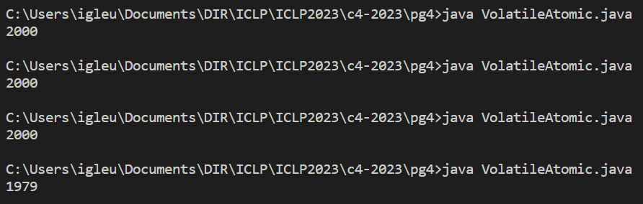
Variabile volatile NU asigura atomicitatea
import java.util.concurrent.atomic.AtomicInteger;
public class AtomicCounter {
private static volatile int counter = 0;
public static void main(String[] args) throws InterruptedException{
Thread t1 = new Thread(new Runnable() {
public void run() {for (int i = 0; i < 1000; i++) counter++; });
Thread t2 = new Thread(new Runnable() {
public void run() {for (int i = 0; i < 1000; i++) counter++;}
});
t1.start(); t2.start();
t1.join(); t2.join();
System.out.println(counter);
1979

Slide 47
Variabilele volatile
sunt folosite atunci cand exista un thread care le actualizeaza si (eventual) mai multe care le citesc,
situatia tipica fiind variabila de control a unui ciclu
public class VolatileEx {
static volatile boolean stop=false;
public static void main(String[] args) throws InterruptedException{
Thread t1 = new Thread(new Runnable() {
public void run() {int count =0;
while (!stop) {count++; System.out.println(count); }
System.out.println(count); });
Thread t2 = new Thread(new Runnable() {
public void run() {try{Thread.sleep(10);} catch (InterruptedException e) {}
stop=true;}});
t1.start(); t2.start();
t1.join(); t2.join();
System.out.println("STOP"); }
cu volatile
30606937
STOP
fara volatile
nu afiseaza nimic

Slide 48
Pe săptămâna viitoare!

